Slide 1

Database Lecture 7
DB Design Exercises
Lecture Addendum
Dr. Jefferson Fong

Slide 2
Announcements
Assignment 2 has been released in iSpace.
  Due Sunday Nov 9, 11:59 pm
Project Groups
Is in iSpace under Section 1002 / 1005
Every group should have at least 1 or 2 people taken System and Web Development workshop.
  Let us know if that’s not so.
Project description due Sun Nov 9.
Project ER diagram due Sun Nov 23.

Slide 3
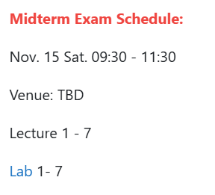
Announcements
Anyone who cannot attend at that time must apply for official excuse form in order to take the make-up test.
Closed book, no notes or any electronic devices allowed.
Bring a pen (or two) and your UIC or government issued photo ID card.

Slide 4
In previous lectures, we spent lots of time giving you theory.
In this lecture, we do exercises for you to practice applying the theory.

Slide 5
Exercise 1
Construct an ER diagram for a car-insurance company. The model includes
  each customer is described by a unique id, a name, and an address;
  each car is described by a unique vehicle identification number, the manufacturer, and the year of production;
  each accident is described by a unique report number, the date and the location when the accident happens;
  each customer owns one or more cars;
  every car is owned by at exactly one customer;
  each accident is only responsible to the owner of the car, no matter who drives;
  it is possible that multiple cars involve in a same accident and the amount of insurance claim for different cars are different.
List all assumptions that you make.
And convert your ER diagram to a logical design.
Step1
Highlight (or circle) important nouns that might be entities.
Highlight (or underline) verbs that might be relationships.
  Sometimes we convert a noun into a verb, e.g. Instructor PD Program.
Do obvious ones first; do the rest later.
Use a pencil and eraser, or do in scratch paper first.

Slide 6
Exercise 1, Step 2
First draw the entities (nouns): customer, car, accident.
Then add in relationships (verbs): own, involve (participate)
customer
own
car
Add in attributes.
  Cross them out in the description after you added them in the diagram.
Add constraints.
  One customer owns many cars (1 to many).
  “Every car is owned by exactly 1 customer”; cars fully participating.
  “Each accident only responsible … owner”; don’t need to consider the driver in accident report.
  Assume accident report must involve at least one car; accident entity is total participation.
participate
accident

Slide 7
Step 3: After finished ER diagram, do logical design (schema)
Schema for customer entity: customer = (cid, name, address)
  List the key cid first with underline.
“Customer own car” is a 1-to-many relationship.
  Don’t need a table for the relationship own.
  Put the cid, the key for customer (the “one”) into the car table as the foreign key.
  Schema for car entity: car = (vin, model, year, cid).
  The tables customer and car can be linked together using a join on cid.
  Draw the tables with sample values to help you figure out the constraints.
    Customer C1 has many cars.
    Customer (one) Car (many)
cid | name | address
C1
C2
C3
vin | model | year | cid
V1 |  |  | C1
V2 |  |  | C1
V3 |  |  | C3
C for customer
V for vehicle

Slide 8
Step 3 (continue)
“Car participate accident” is a many-to-many relationship.
  Need a table for the relationship participate = (vin, rnumber, amount)
    Typo in the answer (given next week); diagram and table should have rnumber rather than report_number or r_number.
  A car can participate in many accidents (with different time or location).
    Car V1 participates in accident R1 and R2.
  An accident can involve many cars.
    Accident report R1 involves car V1 and V3.
  Car (many) Participate (involve) Accident (many)
vin | model | year | cid
V1
V2
V3
vin | r_number | amount
V1 | R1
V1 | R2
V3 | R1
r_number | location | date
R1
R2
R3

Slide 9
Exercise 2
Highlight entity nouns: patient, doctor, test
Highlight relationship verbs: perform, dr_patient (care for), patient-test
patient
dr_patient
doctor
patient-test
test
perform
Add in attributes and adjust the locations of the elements in the diagram.
Add in more stuff from the description; cross out stuff used already.

Slide 10
Exercise 2
Constraints
“Every patient is cared by one or multiple doctor”
  In relationship dr_patient
    Can change dr-patient to care; solution didn’t do that, so leave it in.
  Many doctor to many patient.
  Entity patient is total participating.
“Every test is performed by one or more doctor”
  Many test to many doctor
  Entity test is total participating
“Every test is done (test_patient) for exactly one patient”
  One patient to many test
  Entity test is total participating

Slide 11
Schema Exercise 2
Schema for entities are straight forward, e.g.
  patient = (pid, pname, insurance), doctor = (did, dname, specialization)
Patient – doctor is a many-to-many relationship
  Need a table for the relationship dr_patient = (pid, did).
“Doctor perform test” is a many-to-many relationship
  Need a table for the relationship perform = (did, tid).
Patient – test is a 1-to-many relationship.
  Don’t need a table for patient_test.
  Put pid, the key for patient (the “one”) as a foreign key in the table test, so
    test = (tid, tname, date, time, result, pid)

Slide 12
Exercise 3
Create an ER diagram for a recording company with the following requirements:
  Each musician has an unique SSN (key for musician table), a name, an address, and a phone number.
  Each instrument has a name (e.g., guitar) and musical key (e.g., in C, to confuse you).
  Each album that has a title, a copyright date, a format (e.g., CD), and an album identifier.
  Each song has a title and an author.
  Musicians may play many instruments, and an instrument may be played by many musicians.
  Each album has a number of songs on it, but no song may appear on more than one album.
  Each song is performed by one or more musicians, and a musician may perform a number of songs.
  Each album has exactly one musician who acts as its producer. A musician can of course produce several albums.

Slide 13
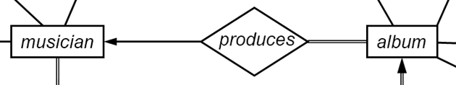
Schema Exercise 3
“Each album has exactly one musician who acts as its producer. A musician can of course produce several albums.”
  Similar to instructor PD program, with an instructor allowed to be PD in more than 1 programs. (This is true in BNBU.)
  Case 7 in Lecture 6; has a “one” and the “many” entity album totally participating.
  No schema is needed for relationship “produces”, with the ssn (key for musician) appearing in the table album.
  album = (aid, atitle, crdate, format, ssn)

Slide 14
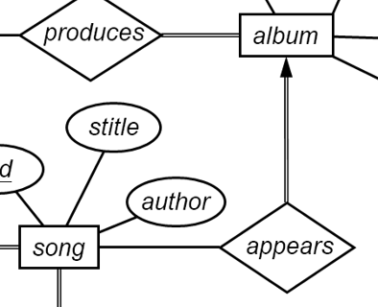
Schema Exercise 3
“Each (one) album has a number of (many) songs on it, but no song may appear on more than one album.”
  Case 6 in Lecture 6; has a “one” and the “many” entity song partially participating.
  Need a schema for appears = (sid, aid)
  If we try song = (sid, stitle, author, aid) as we did in case 7, some row may have a null value for aid (foreign key) if that song is not in any album.
Piece together “musician produces album” with “song appears album”.
Then add in “musician perform song”

Slide 15
Summary of ER Diagram Design
Modeling
Constraints
ER Model
Weak Entity
Extended
Design Issue
Design Tech
Practice
To Schema
E
entity set
R
relationship set
A
attribute
E
weak entity set
R
identifying
relationship set
A
multivalued
attribute
R
E
total
participation
many-to-many
relationship
A
derived
attribute
R
R
1..h
E
cardinality
limits
R
many-to-one
relationship
A
primary key
R
role
name
E
role
indicator
one-to-one
relationship
A
R
discriminator
ISA
ISA
ISA
total
generalization
ISA
disjoint
generalization
disjoint

